Slide 1
ADO.NET
Sunita Jain

Slide 2
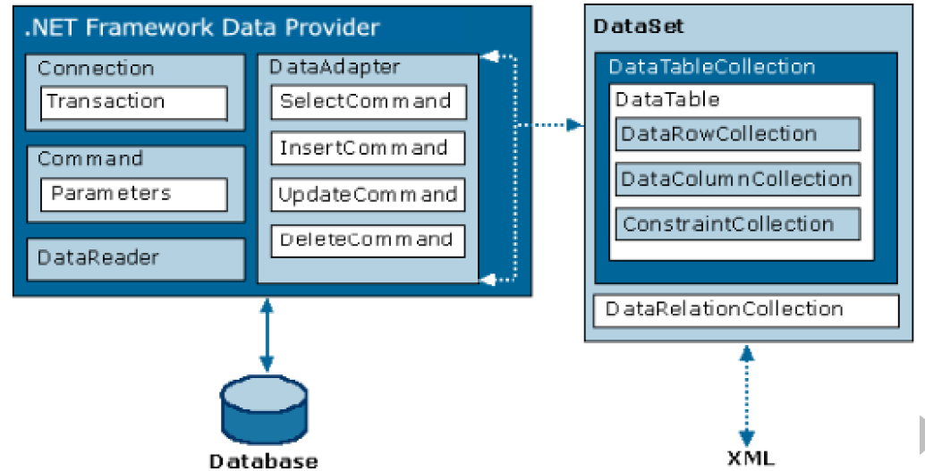
ADO.NET Architecture and Role of Managed Provider

Slide 3
Role of Managed Provider
It is a .Net component implementing certain standard set of interfaces provided by Microsoft, for a specific type of backend.
Following are the four managed providers which are built in along with MS.NET Framework.

Slide 4
Role of Managed Provider
Provider Name | Namespace | API prefix | Data Source Description
ODBC | System.Data.Odbc | Odbc | Data Sources with an ODBC interface. Normally older data bases.
OleDb | System.Data.Oledb | OleDb | Data Sources that expose an OleDb interface, i.e. Access or Excel.
Oracle | System.Data.OracleClient | Oracle | For Oracle Databases.
SQL Server | System.Data.SqlClient | Sql | For interacting with Microsoft SQL Server.

Slide 5
Important Objects in Managed Provider (ADO.NET Objects):
Connection: Connection object encapsulates the functionally of establishing a communication path over the sockets.
Command: Command Object can be used for execution of any type of Sql Statement including Stored Procedures.
Data Reader: Used to fetch data returned from result of execution of Select statement.
Data Adapter: Used to create DataSet which is disconnected model of operating with database.

Slide 6
What is Connection Pooling?
In .Net, Connections are ‘Pooled’. We can have by default up to 100 simultaneous connections without closing but obviously we have to close every connection Opened only then it can be reused from Pool i.e. keeps the connection with the database open for the short period of time. The Connection Pooling can be customized by setting appropriate parameters in ConnectionString of Connection Object and this cannot be done for Oledb and ODBC managed providers.
For two or more connection objects to share a common connection in the pool their connection strings must match.
<connectionStrings>
<add name="MSDemoCS" connectionString="server=.\sqlexpress;database=msnetdemodb;
Integrated Security=true; max pool size=200;Pooling=false"/>
</connectionStrings>

Slide 7
Performing Insert, Update and Delete Operations
Steps to execute any SQL Statement
1.Create a Connection
2. Create a Command
3. Bind the Command to Connection
4. Initialize Command with SQL Statement to execute
5. Open the Connection
6. Execute the Command
7. Close the Connection

Slide 8
SQLCommand Methods for execution of Commands:
int ExecuteNonQuery(): Used for execution of those statements which do not return any data from backend to frontend. – return
Object ExecuteScalar() - Used for execution of statements which return only one value.- return Object
SqlDataReader ExecuteReader() - Used for execution of statements which return multiple rows and columns i.e. a set of records.

Slide 9
Fetching Data from Database – Select Statement
SqlDataReader :
When “Select” or similar type of sql statement is executed a new cursor (memory area in backend) is created on the back end. This Cursor contains primary key or indexed key of the table on which the statement is executed for the records which have qualified the condition in the where clause of the select statement. It also has a pointer, which is by default positioned at BOF.
The cursor and pointers functionality is encapsulated by the “DataReader” object created in the front end. Using this object, we can move the pointer in the forward direction getting one record from backend into the front-end at the time.
The cursor managed by Data Reader is read-only and forward-only

Slide 10
MARS
By Default we can have only one data reader opened at a time on one connection object.
If MultipleActiveResultSets=True is added to the connection string then more than one data reader can be opened at the same time on the single connection object. It’s a feature in Ado.net 2.0

